Slide 1


June 2020
Category review: Chips
Retail Analytics
1
Classification: Confidential

Slide 2
Our 17 year history assures best practice in privacy, security and the ethical use of data
We all have a responsibility to use data for good
Privacy
Security
Ethical use of data
Applies to all facets of our work, from the initiatives we take on, the information we use and how our solutions impact individuals, organisations and society.
We have built our business based on privacy by design principles for the past 17 years
Quantium has strict protocols around the receipt and storage of personal information
All information is de-identiﬁed using an irreversible tokenisation process with no ability to
re-identify individuals.
We are ISO27001 certiﬁed - internationally recognised for our ability to uphold best practice standards across information security
We use ‘bank grade’ security to store and process our data
Comply with 200+ security requirements from NAB, Woolworths and other data partners
All partner data is held in separate restricted environments
All access to partner data is limited to essential staff only
Security environment and processes regularly audited by our data partners.
Quantium believes in using data for progress, with great
care and responsibility. As such please respect the commercial in conﬁdence nature
of this document.
2
Classification: Confidential

Slide 3
Executive summary
1
Chips Category Review
Chips transactions increase substantially prior to Christmas. It is a good time to take advantage of this momentum with promotional offers.
Older and Young Family segment have the highest average purchase units per unique customer.
Sales mainly came from Budget - older families, Mainstream - young singles/couples, and Mainstream - retirees. In total contributing 25% of sales revenue.
2
Trial Store Analysis
Trial store 77 and 86 experienced signiﬁcant increase in Total Sales and Customers quantity during the trial period compared to their control stores..
Trial store 88 experience increase as well, but insigniﬁcant compared to its’ Control store.

Slide 4
Category
01

Slide 5
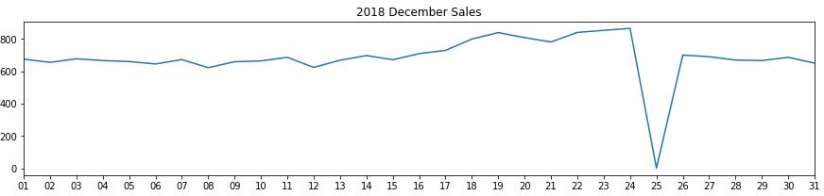
As Christmas approaches, sales gradually grow. On New Year's Eve, they resume their early December levels. The fact that stores were closed on December 25 as a result of Christmas contributed to the drop in sales.

Slide 6
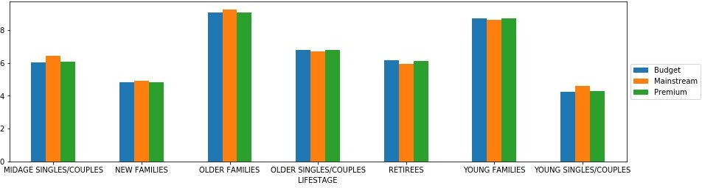
The amount of purchases made by each consumer does not appear to be affected by wealth.The segments with the highest average purchase units per distinct client are Older and Young Families.

Slide 7
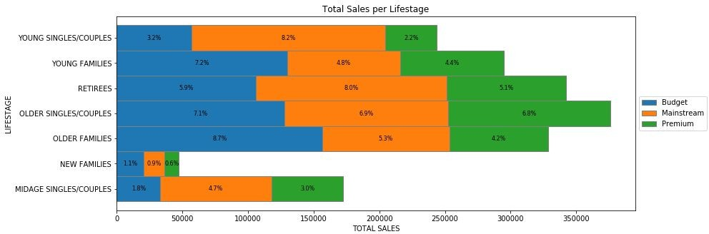
Budget - older families, Mainstream - young singles/couples, and Mainstream - retirees accounted for the majority of sales. Overall, older clients spend more money than younger ones. Customers who don't pay a premium purchase more than those who do.

Slide 8
02
Trial store performance

Slide 9
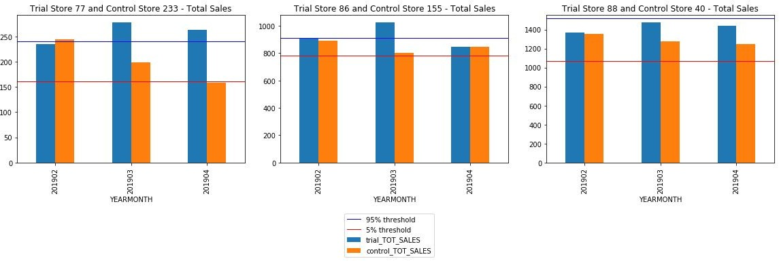
Sales at Trial Stores 77 and 86 in their second and third months were noticeably higher than at Control Store in its second month.Trial Store 88's sales growth, however, is negligible.

Slide 10
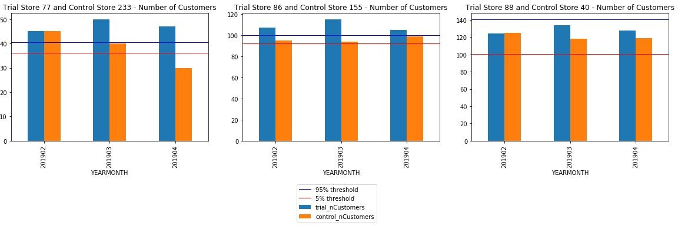
Customers visited Trial Stores 77 and 86 significantly more frequently than Control Stores over the Trial period, demonstrating the success of the trial.However, the increase of 88 clients at the trial store is negligible.

Slide 11
Disclaimer: This document comprises, and is the subject of intellectual property (including copyright) and conﬁdentiality rights of one or multiple owners, including The Quantium Group Pty Limited and its aﬃliates (Quantium) and where applicable, its third-party data owners (Data Providers), together (IP Owners). The information contained in this document may have been prepared using raw data owned by the Data Providers. The Data Providers have not been involved in the analysis of the raw data, the preparation of, or the information contained in the document. The IP Owners do not make any representation (express or implied), nor give any guarantee or warranty in relation to the accuracy, completeness or appropriateness of the raw data, nor the analysis contained in this document. None of the IP Owners will have any liability for any use or disclosure by the recipient of any information contained in, or derived from this document. To the maximum extent permitted by law, the IP Owners expressly disclaim, take no responsibility for and have no liability for the preparation, contents, accuracy or completeness of this document, nor the analysis on which it is based. This document is provided in conﬁdence, may only be used for the purpose provided, and may not be copied, reproduced, distributed, disclosed or made available to a third party in any way except strictly in accordance with the applicable
11
written terms and conditions between you and Quantium, or otherwise with Quantium’s prior written permission

